Slide 1
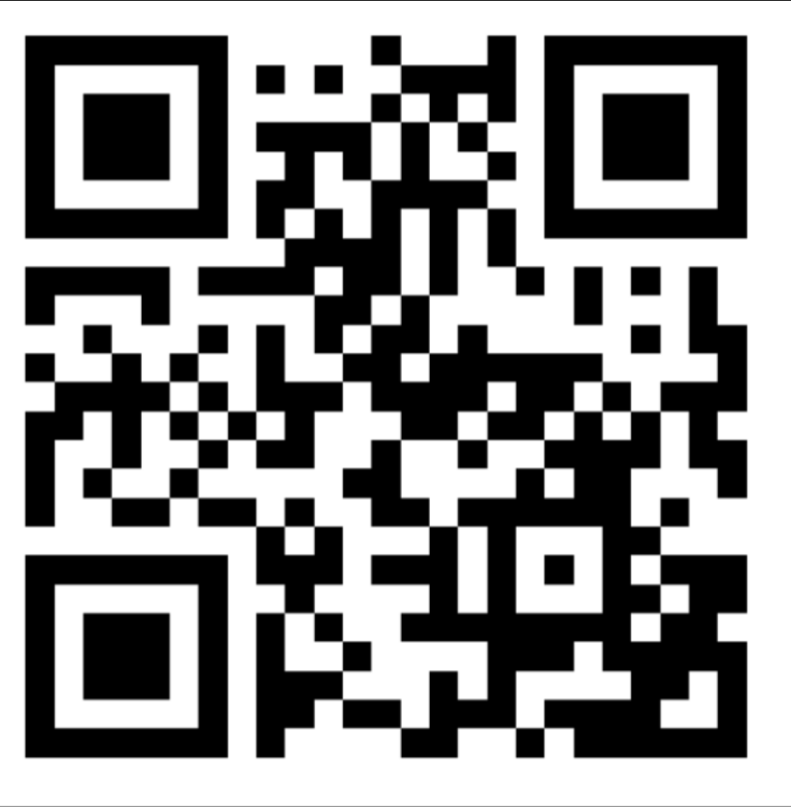
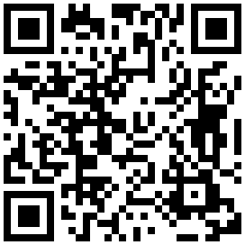

Welcome to GAI
Discord
Officer Application
Instagram
Last Meeting
https://z.umn.edu/officer-interest

Slide 2
Schedule
AI Presentation
Grab food
Project work time, ask questions
Feel free to just hang out, talk, or study for finals, etc

Slide 3
Presentation!!

Slide 4
Awesome ML Resources

Slide 5
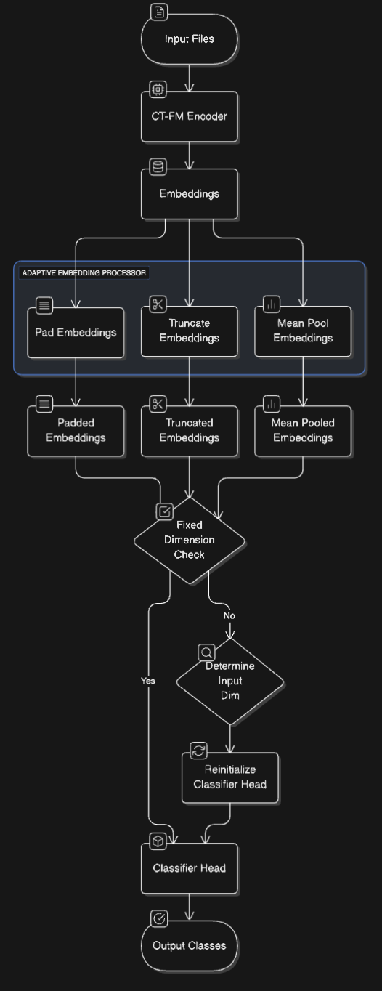
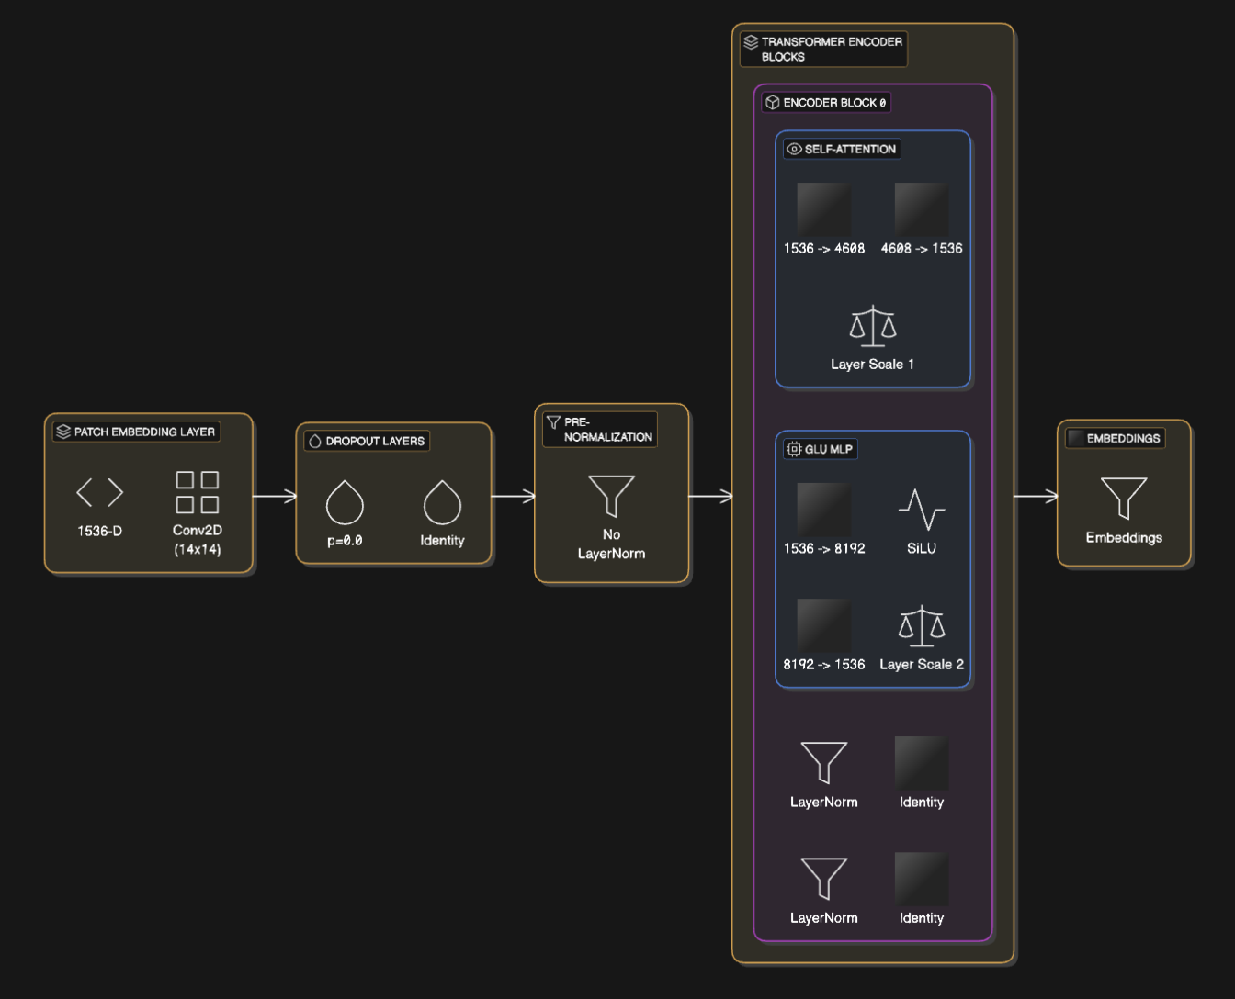
Eraser IO: Code to diagram generator
https://app.eraser.io/new
Will take 2 seconds to automatically draft an editable diagram of your network.

Slide 6
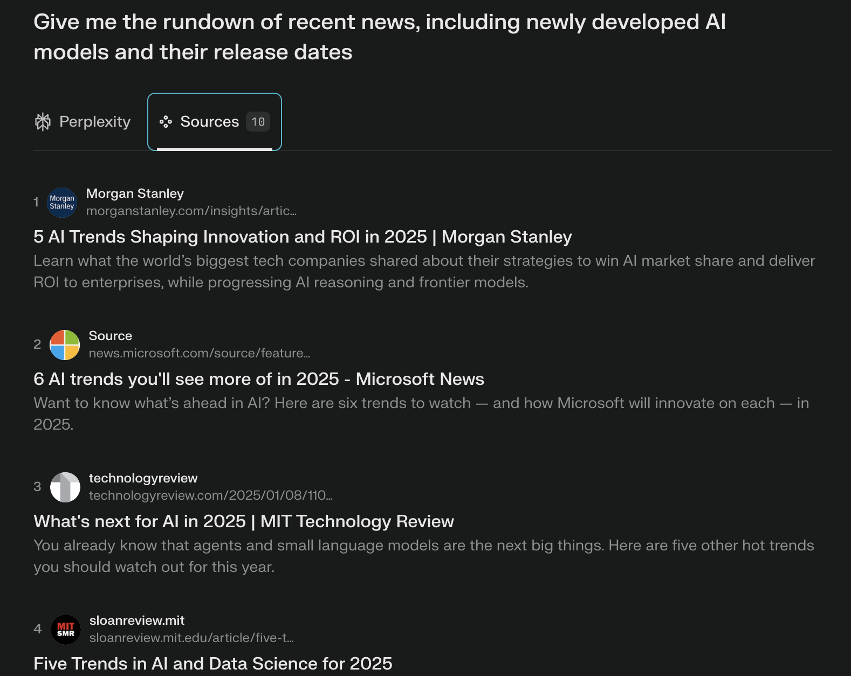
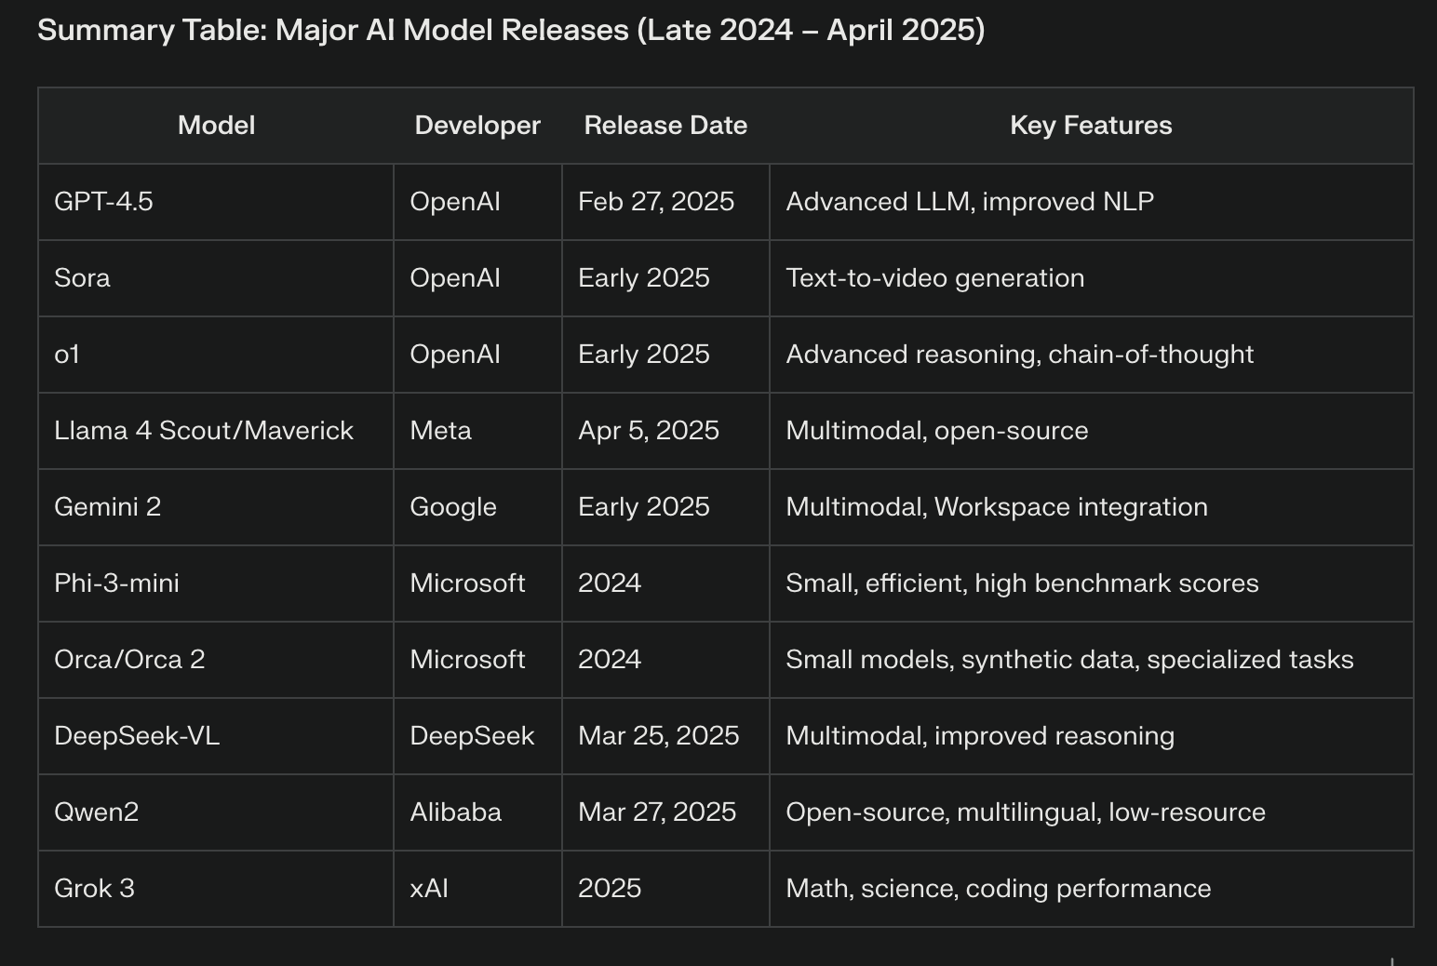
Perplexity: Real-time LLM responses with search, & sources
https://www.perplexity.ai/
…

Slide 7
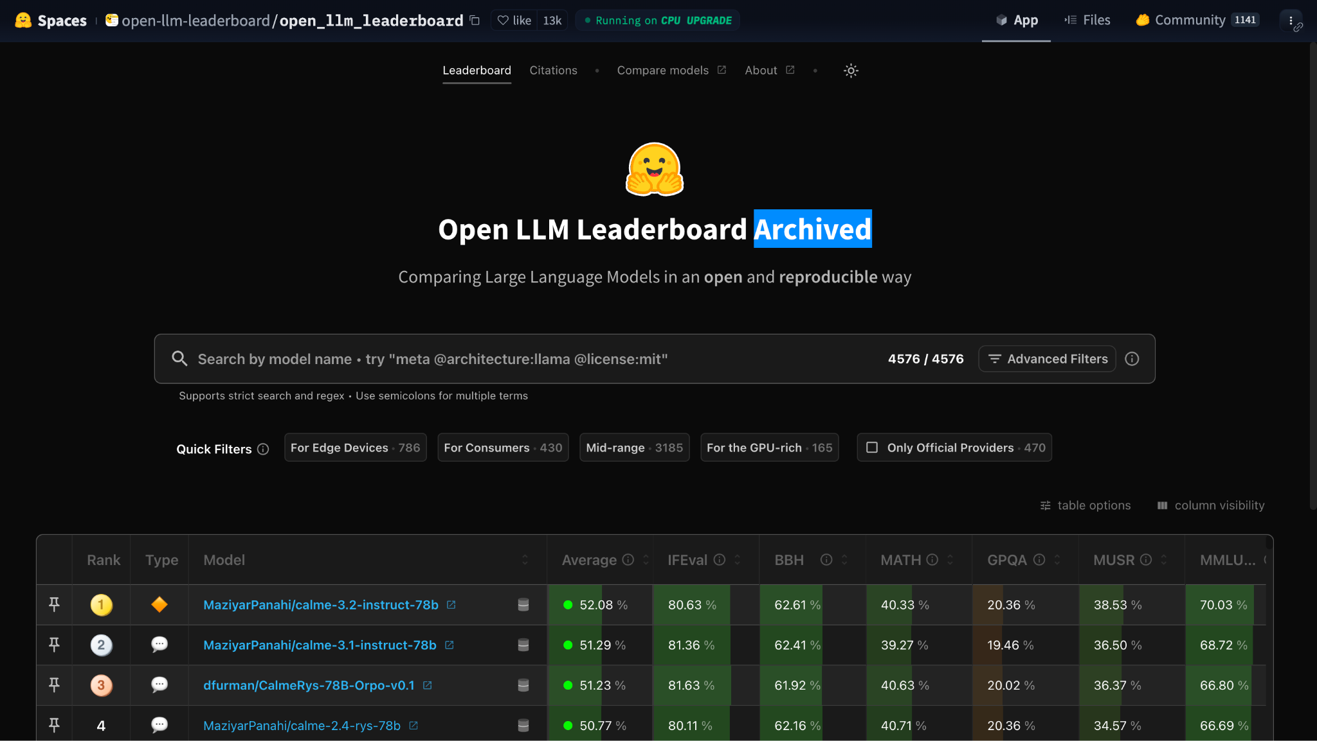
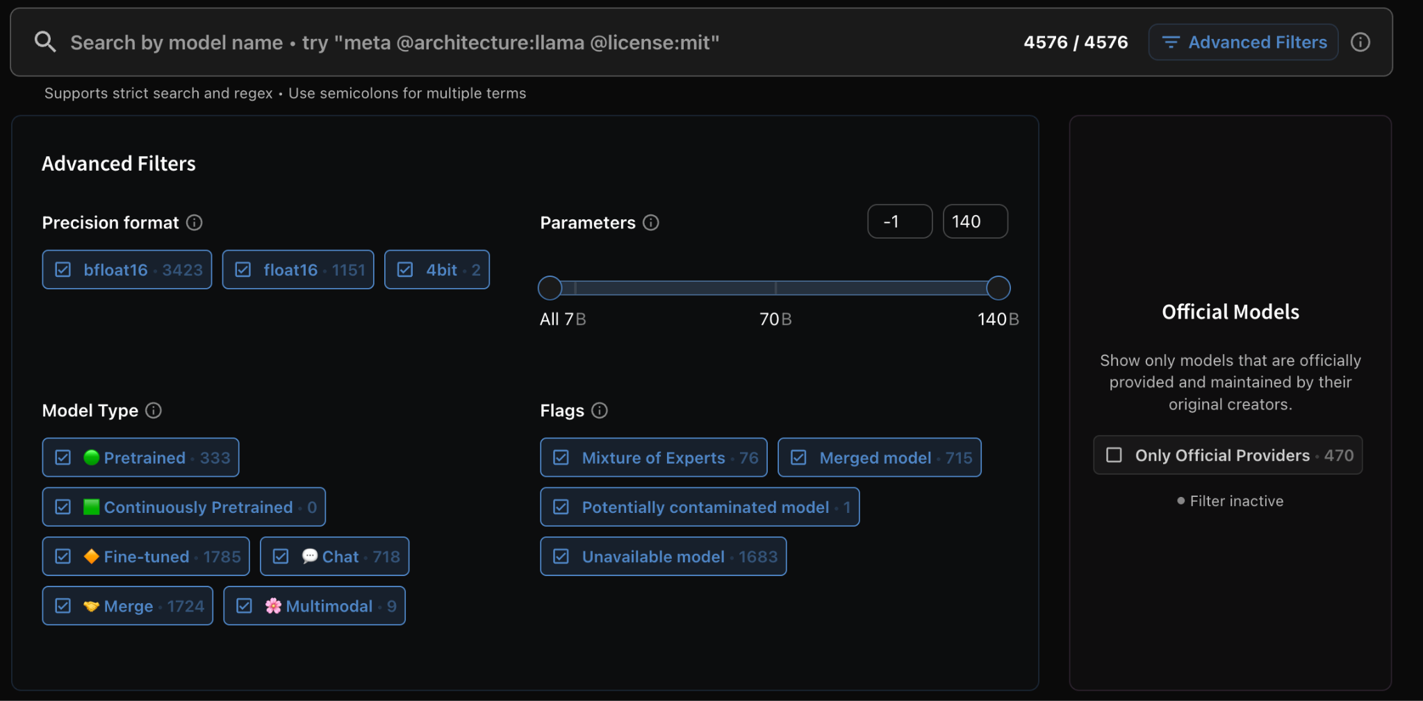
HuggingFace Open LLM Leaderboard
https://huggingface.co/spaces/open-llm-leaderboard/open_llm_leaderboard#/

Slide 8
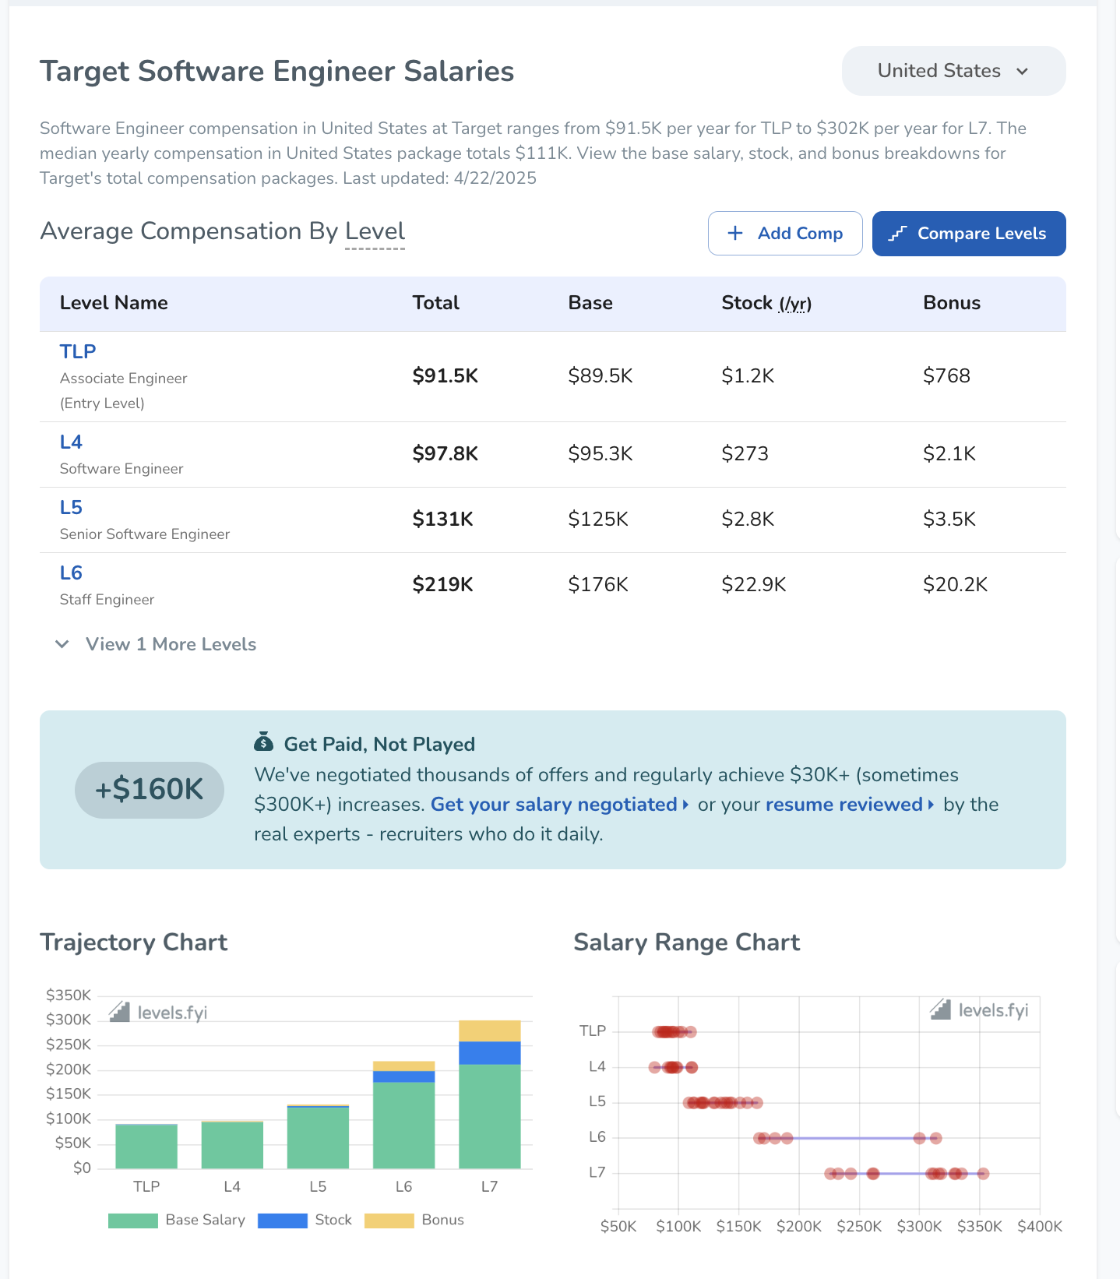
Others
NotebookLM
Codemium (free codebase assistant)
Levels.fyi - great salary reporting site for CS (has specific instances to look at)

Slide 9
Food and socialize
Feel free to ask us questions!!

Slide 10
Project Links
https://z.umn.edu/gai-jobapp
https://z.umn.edu/gai-aita

Slide 11
THANK YOU!
for attending our meetings this semester :D

